Slide 1
4th grade
Data Analysis
and Statistics
Here is where your presentation begins

Slide 2
Contents of this template
You can delete this slide when you’re done editing the presentation
Fonts | To view this template correctly in PowerPoint, download and install the fonts we used
Used and alternative resources | An assortment of graphic resources that are suitable for use in this presentation
Thanks slide | You must keep it so that proper credits for our design are given
Colors | All the colors used in this presentation
Icons and infographic resources | These can be used in the template, and their size and color can be edited
Editable presentation theme | You can edit the master slides easily. For more info, click here
For more info: SLIDESGO | BLOG | FAQs
You can visit our sister projects: FREEPIK | FLATICON | STORYSET | WEPIK | VIDEVO

Slide 3
What will we learn in this lesson?
01.
02.
03.
04.
Mathematical thinking
Let’s solve problems and learn about mathematical reasoning
Mathematical concepts
We’ll build on simple concepts as a foundation for future learning
Playing with numbers
Numbers are awesome! Let’s have fun with today’s topic
Real life applications
We’ll see how we can use this concept in real everyday life

Slide 4
Introduction
Here you can establish a relatable context for the concept, linking it to everyday experiences familiar to your students. This may involve discussing common situations or objects, providing a real-world context that serves as a foundation for the upcoming lesson. By creating a tangible connection, you set the stage for engagement and prepare students to explore the mathematical idea with a sense of relevance for their lives
You can also use this space for illustrative examples, a short text-based problem, or an engaging story that resonates with your students. By weaving the mathematical idea into real-life scenarios and encouraging exploration, you pique your students’ curiosity and create an environment where students not only grasp the concept but also begin to appreciate its relevance in their everyday experiences

Slide 5
01.
Mathematical thinking
Let’s learn how to approach math problems

Slide 6

Understanding math problems
Let’s tackle math problems like experts! Here’s your three-step guide:
Read carefully and understand
Make a plan for solving the problem
Go step by step and don’t rush!
Be thorough, take your time and you’ll conquer any math problem!

Slide 7
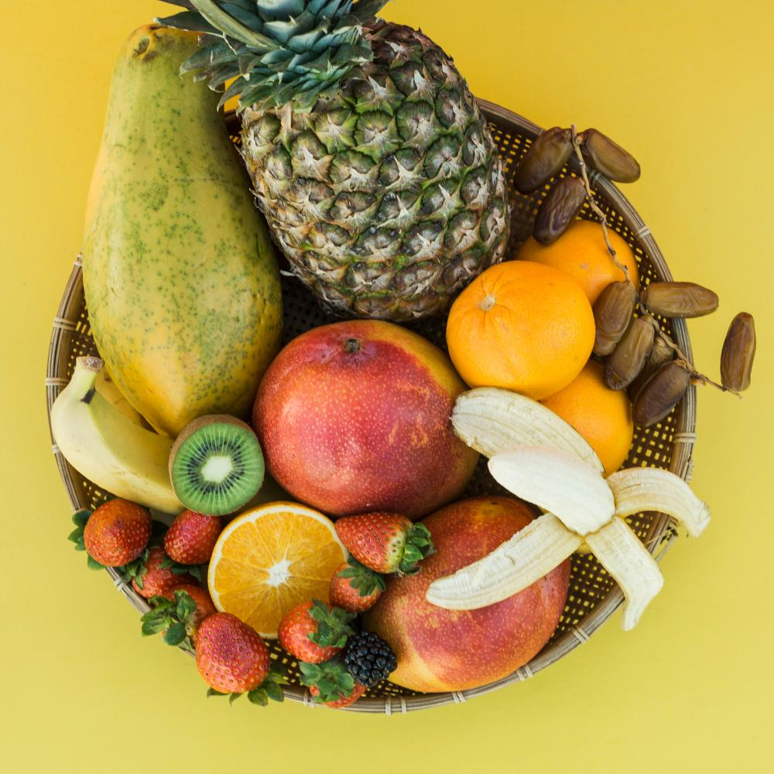
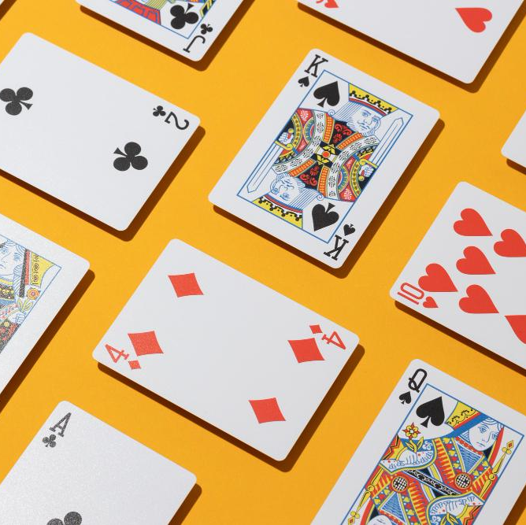



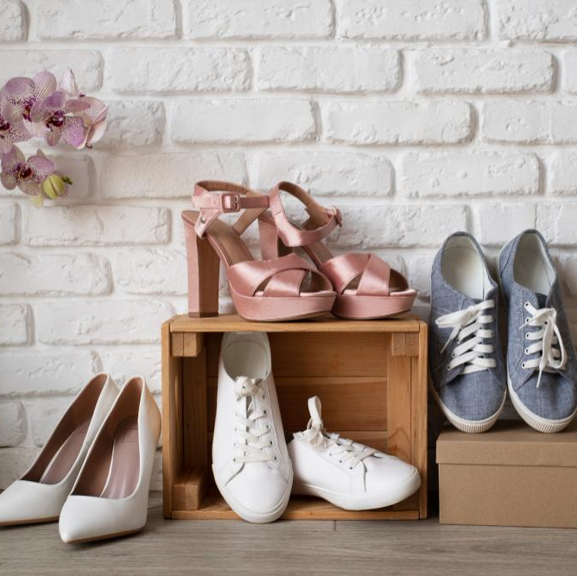
Activity 1: Counting challenge
Insert images of objects around the class. Students should count how many of these objects they can find. Afterwards, you can do more operations with these numbers
How
many?
How
many?
How
many?
??
??
??
How
many?
How
many?
How
many?
??
??
??

Slide 8
Mathematical concepts
Numbers
Math is all about numbers, like counting how many friends you have or how many apples are in a basket
Shapes
Let’s talk about different shapes. Think of a square, a circle, or a triangle — they help us understand
Adding and taking away
We use math to add things together, like counting toys, and to take things away

Slide 9

Experiment: Tower building
Give students cards and challenge them to build the tallest tower within a time limit
and measure the height. Afterwards you can reflect on how to apply math concepts to the experiment
Materials
Index or playing cards
Timer
Reflection questions
1.
How did you use numbers, shapes, or measurements in the experiment?
Did you find any particular math skills more helpful than others in this activity?
3.
2.
Can you identify any patterns between the elements in your tower?

Slide 10
Playing with numbers
Number games
Have fun playing games that involve counting and comparing numbers. It can be as simple as rolling dice, counting toy cars, or arranging objects in order
Puzzle fun
Solve simple puzzles that use numbers. Connect the dots, figure out number patterns, or play with number puzzles to make learning about numbers enjoyable

Slide 11
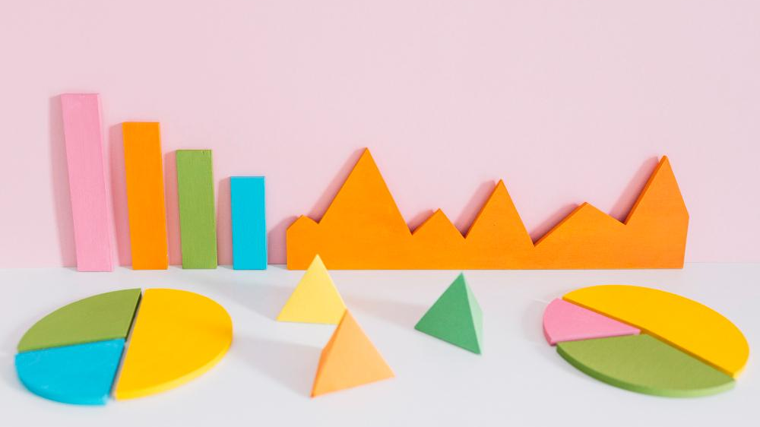
Every number tells a story

Slide 12
Why do we learn about math?
Building things
Playing games
Builders use math to measure and create structures like houses
Board games and puzzles often involve counting, adding, or strategizing
Sharing treats
Cooking time
Math is handy for sharing snacks with friends, so all get a fair amount
We use math to measure ingredients when cooking delicious meals
Time management
Shopping smart
Math helps us read the clock, so we know when it's time for school or play
Math helps us count money and check we get the right change while buying things

Slide 13
Activity 2: Pattern hunt
On the left, you can write a sequence of numbers following a pattern. On the right, write the type of pattern. Students should identify and connect the number and pattern
Sequence 1
Sequence 2
Sequence 3
Sequence 4
Pattern 3
Pattern 1
Pattern 4
Pattern 2

Slide 14
Math is part of our everyday life

Slide 15
123,456
How high can you count?

Slide 16
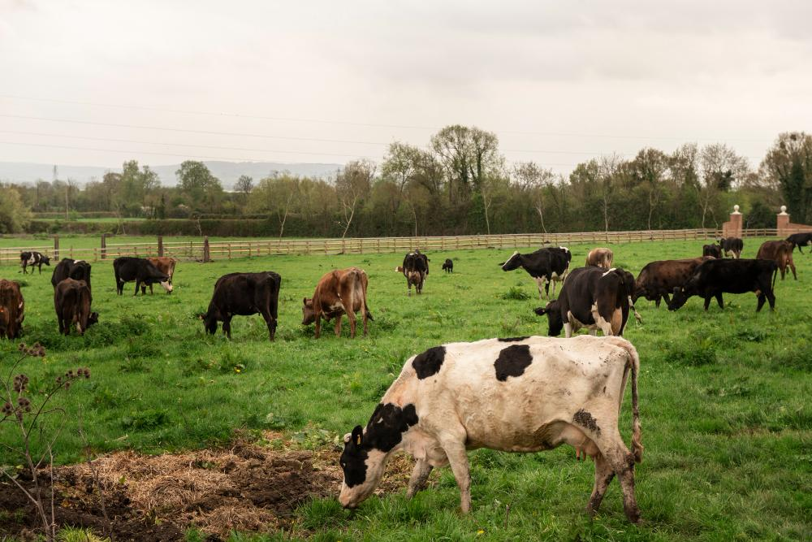


Activity 3: Math in the real world
Share three images, students should identify mathematical concepts in each of them
1.
How many cows can
you find?
1.
How many students are reading?
1.
What time does the clock show?
2.
Identify black, white and brown cows
2.
What objects can you see?
2.
Where will the hands point after one hour?

Slide 17
Here’s a timeline for you
20XX
20XX
Event 1
Event 3
You can speak about this event here
You can speak about this event here
20XX
20XX
Event 2
Event 4
You can speak about this event here
You can speak about this event here

Slide 18
What have we learned?
Problem -solving
Critical thinking
Number skills
Patterns and relationships
Real-world applications

Slide 19
Game time: Treasure hunt
Choose a topic, create a treasure and prepare a series of clues related the subject. Students will have to solve puzzles and do actions in order to reach the treasure
Write your first clue
Delete to show your clue 1
Teams | Clue 1 | Clue 2 | Clue 3
Team 1
Team 2
Write your second clue
Delete to show your clue 2
Write your third clue
Delete to show your clue 3

Slide 20
Thanks!
Do you have any questions?
youremail@freepik.com
+34 654 321 432
yourwebsite.com
Please keep this slide for attribution

Slide 21
Alternative resources
Here’s an assortment of alternative resources whose style fits that of this template:
Vectors
Statistics big data background
Flat infographic elements collection

Slide 22
Resources
Did you like the resources used in this template? Get them on these websites:
Vectors
Hand drawn data analysis template
Photos
Frame of economy charts
Different colorful graph with pyramid shapes against pink background
Flat lay of statistics presentation with chart and arrows
Colorful composition of fresh fruit
Cute pet collage isolated
Casino cards on yellow background
Full shot smiley students in library
Front view of stack of books with one open
Spring wardrobe switch over still life
Cows grazing in nature
Students using laptop in park
Close-up of alarm clock

Slide 23
Instructions for use
If you have a free account, in order to use this template, you must credit Slidesgo by keeping the Thanks slide. Please refer to the next slide to read the instructions for premium users.
As a Free user, you are allowed to:
Modify this template.
Use it for both personal and commercial projects.
You are not allowed to:
Sublicense, sell or rent any of Slidesgo Content (or a modified version of Slidesgo Content).
Distribute Slidesgo Content unless it has been expressly authorized by Slidesgo.
Include Slidesgo Content in an online or offline database or file.
Offer Slidesgo templates (or modified versions of Slidesgo templates) for download.
Acquire the copyright of Slidesgo Content.
For more information about editing slides, please read our FAQs or visit our blog:
https://slidesgo.com/faqs and https://slidesgo.com/slidesgo-school

Slide 24
Instructions for use (premium users)
As a Premium user, you can use this template without attributing Slidesgo or keeping the "Thanks" slide.
You are allowed to:
Modify this template.
Use it for both personal and commercial purposes.
Hide or delete the “Thanks” slide and the mention to Slidesgo in the credits.
Share this template in an editable format with people who are not part of your team.
You are not allowed to:
Sublicense, sell or rent this Slidesgo Template (or a modified version of this Slidesgo Template).
Distribute this Slidesgo Template (or a modified version of this Slidesgo Template) or include it in a database or in any other product or service that offers downloadable images, icons or presentations that may be subject to distribution or resale.
Use any of the elements that are part of this Slidesgo Template in an isolated and separated way from this Template.
Register any of the elements that are part of this template as a trademark or logo, or register it as a work in an intellectual property registry or similar.
For more information about editing slides, please read our FAQs or visit our blog:
https://slidesgo.com/faqs and https://slidesgo.com/slidesgo-school

Slide 25
Fonts & colors used
This presentation has been made using the following fonts:
Passion One
(https://fonts.google.com/specimen/Passion+One)
Inter
(https://fonts.google.com/specimen/Inter)
#17175a
#ffffff
#f6f2cc
#fcbd0e
#fa9d02
#fc81fd
#7ce1cf
#6e6fff

Slide 26





Storyset
Create your Story with our illustrated concepts. Choose the style you like the most, edit its colors, pick the background and layers you want to show and bring them to life with the animator panel! It will boost your presentation. Check out how it works.
Pana
Amico
Bro
Rafiki
Cuate

Slide 27
Use our editable graphic resources...
You can easily resize these resources without losing quality. To change the color, just ungroup the resource and click on the object you want to change. Then, click on the paint bucket and select the color you want. Group the resource again when you’re done. You can also look for more infographics on Slidesgo.

Slide 30
JANUARY
FEBRUARY
MARCH
APRIL
MAY
JUNE
PHASE 1
Task 1
Task 2
PHASE 2
Task 1
Task 2
JANUARY
FEBRUARY
MARCH
APRIL
PHASE 1
Task 1
Task 2

Slide 33
...and our sets of editable icons
You can resize these icons without losing quality.
You can change the stroke and fill color; just select the icon and click on the paint bucket/pen.
In Google Slides, you can also use Flaticon’s extension, allowing you to customize and add even more icons.

Slide 34
Educational Icons
Medical Icons

Slide 35
Business Icons
Teamwork Icons

Slide 36
Help & Support Icons
Avatar Icons

Slide 37
Creative Process Icons
Performing Arts Icons

Slide 38
Nature Icons

Slide 39
SEO & Marketing Icons

Slide 40


